Slide 1
Arizona_Election_Project
By Darlington L Ezeuduji, Franklin Tello, Joshua Zaragoza and Raymond Grymko

Slide 2
Outline of the Project
What is our Topic
Why we selected our topic
We started with describing our Data Source (which was from the Arizona Democratic Party)
Questions We Hope To answer
Description of our Data Exploration: We cleaned and saved our datasets in multiple ways to fit different types of ML that we applied to our Datasets. And we also transferred and saved the tables to our pgAdmin Database from where we imported them for analysis.
Data Analysis: We performed several ML so as to get a better result as was shown on the python notebooks we have.

Slide 3
Selected Topic
The GETZ group project will be executing an analysis of Arizona's four politically competitive legislative districts. We define "politically competitive" as districts where both Democrats and Republicans have a virtually equal shot at winning the race. We picked the four competitive legislative as our topic given that is where most of both parties resources will be invested on a state level this election and as a result, where our predictive model will have the most impact on Arizona's democracy. In the ballpark of 120,000 registered voters consisting of Republicans, Democrats and Independents reside in each of the four districts.

Slide 4
Why We Selected This Topic
First and foremost, we want to find a way to participate in our democracy, and furthermore, we hope we can have an impact on our local elections. The four districts we have chosen to analyze are the districts that will decide which party controls the agenda of the Arizona legislature.
Secondly, we find voter behavior interesting. According to numerous recent election studies, the American electorate has become hyper-partisan. This means that over the last 20 years voters are becoming more and more hardened in their support of their own party, and equally important, grown more and more negative towards the opposing party. In short, Democratic voters are much less likely to vote for a Republican candidate and vice versa - regardless of the candidate, policies and/or the economic climate. This, in conjunction, with Arizona's emergence on the national political stage over the last 4 years as battleground state, entices us to learn more about Arizona voters. In fact, the voters in these four competitive districts are also the voters that decide which presidential candidate wins in Arizona and therefore plays an instrumental role which party resides in the White House.

Slide 5
Description of Our Data Sources
The primary data source for this project will be the proprietary statewide voter file provided from the Arizona Democratic Party. While the access to this data is from by a partisan organization, the data itself is neutral. As mentioned, each district consists of 120,000 registered voters. Thus, our model will be compiled of roughly 720,000 rows of data. The initial database will have the following columns:
Voter registration ID
Voter ID
First and last name
Address
City
County
Zip Code
Phone number (75% of voters provide this)
Political Party
Legislative District
Congressional District
Gender
Age
Ethnicity/Race
Voting History
Partisan Score (each voter scored on the degree with which they will vote for their own party)
Turnout Score (likelihood of voting)
Kids in Household (whether they have kids in their house)
Liberal Ideology (how ideological or pragmatic each voter is in their support of Liberal issues)

Slide 6
Description of Data Exploration
Click here for data exploration, preprocessing and transformation: Cells 1-15

Slide 7
Description of Data Exploration
In acquiring the proprietary voter data, we linked up our voter tables with a db_string connection. Firstly, we identified the columns that are either irrelevant or non-beneficial to answering our Swing Voter question. Therefore, we dropped these columns in the vetting and cleaning stage of the DataFrame:
Thereafter we converted some dtypes from "Float64" to "Int" and removing all NaN or Null values. Additionally, we simplified the header name of "Partisan Score" to "Voter Score" so it would clear to our audience what this is and how we are using, which will be addressed shortly.

Slide 8
Questions We Hope To Answer
In the execution of this project and our machine learning models, we hope to answer the following questions:
We hope to determine and classify which voters in each district are likely to be a split-ticket voter or so-called "Swing Voter". We are defining a Swing Voter as a voter that is registered as a Democrat, Republican or Other (Independent) that is likely to vote for both parties across their ballot. For example, a Swing Voter could be defined as a registered Republican that voted for a Democratic presidential candidate but votes for Republican congressional and state legislative candidates. In doing so, we will apply a binary classification predictive model with logistic regression.
We also hope to predict which voters of each of the four districts are likely to turn out in the 2022 election. We would likely do this as well with employing a binary classification predictive model with logistic regression. On another level, we hope to predict the likely percentage of voters in each district and the demographic composition to turnout in the 2022 election.

Slide 9
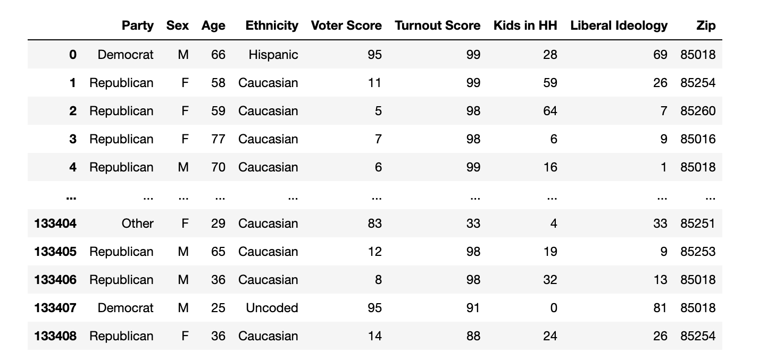
Description of Data Exploration

Slide 10
Description of Data Exploration
Voter registration ID
First and last name
Address
City
County
Zip Code
Phone number (75% of voters provide this)
Party Affiliation
Legislative District
Congressional District
Gender
Birth Date
Age
Ethnicity/Race
Voting History
Partisan Score (the likelihood to vote for their own party)
Turnout Score

Slide 11
In acquiring the proprietary voter data, we linked up our voter tables with a db_string connection. Firstly, we identified the columns that are either irrelevant or non-beneficial to answering our Swing Voter question. Therefore, we dropped these columns in the vetting and cleaning stage of the DataFrame:
Thereafter we converted some dtypes from "Float64" to "Int" and removing all NaN or Null values. Additionally, we simplified the header name of "Partisan Score" to "Voter Score" so it would clear to our audience what this is and how we are using, which will be addressed shortly.
Given our objective of identifying Swing Voters via machine learning and what features are most important and precitive in doing so, we had to identify and define Swing Voters. To that end, we used the "Voter Score" model of scoring Republican, Other(Independent) and Democratic voters between 0-100. Voters that are scored between 0-34 are highly likely to vote Republican with the lower the score the more likely they are to do so. On the other end, voters scoring between 66 and 100 are more likely to vote Democratic, again with the higher the score the increase in likelihood. And for voters that score between 35-65, they are likely to vote for both parties candidates, regardless of what party they are registered with. In this case, the closer they are to the score 50 the more likely they are a truly Independent or Swing Voter. To do our exploratory analysis, we created a list of conditions to assign each voter a new value based on the "Voter Score." Subsequently, we created a new "Swing Voter" column and assigned a "Low_Chance" and "High-Chance" value to each voter and moving forward drop the "Voter Score" column.

Slide 12
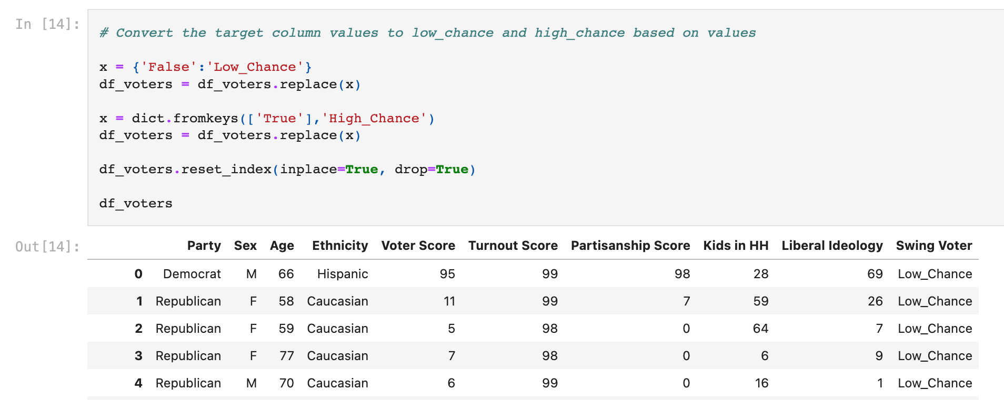
Description of Data Exploration

Slide 13
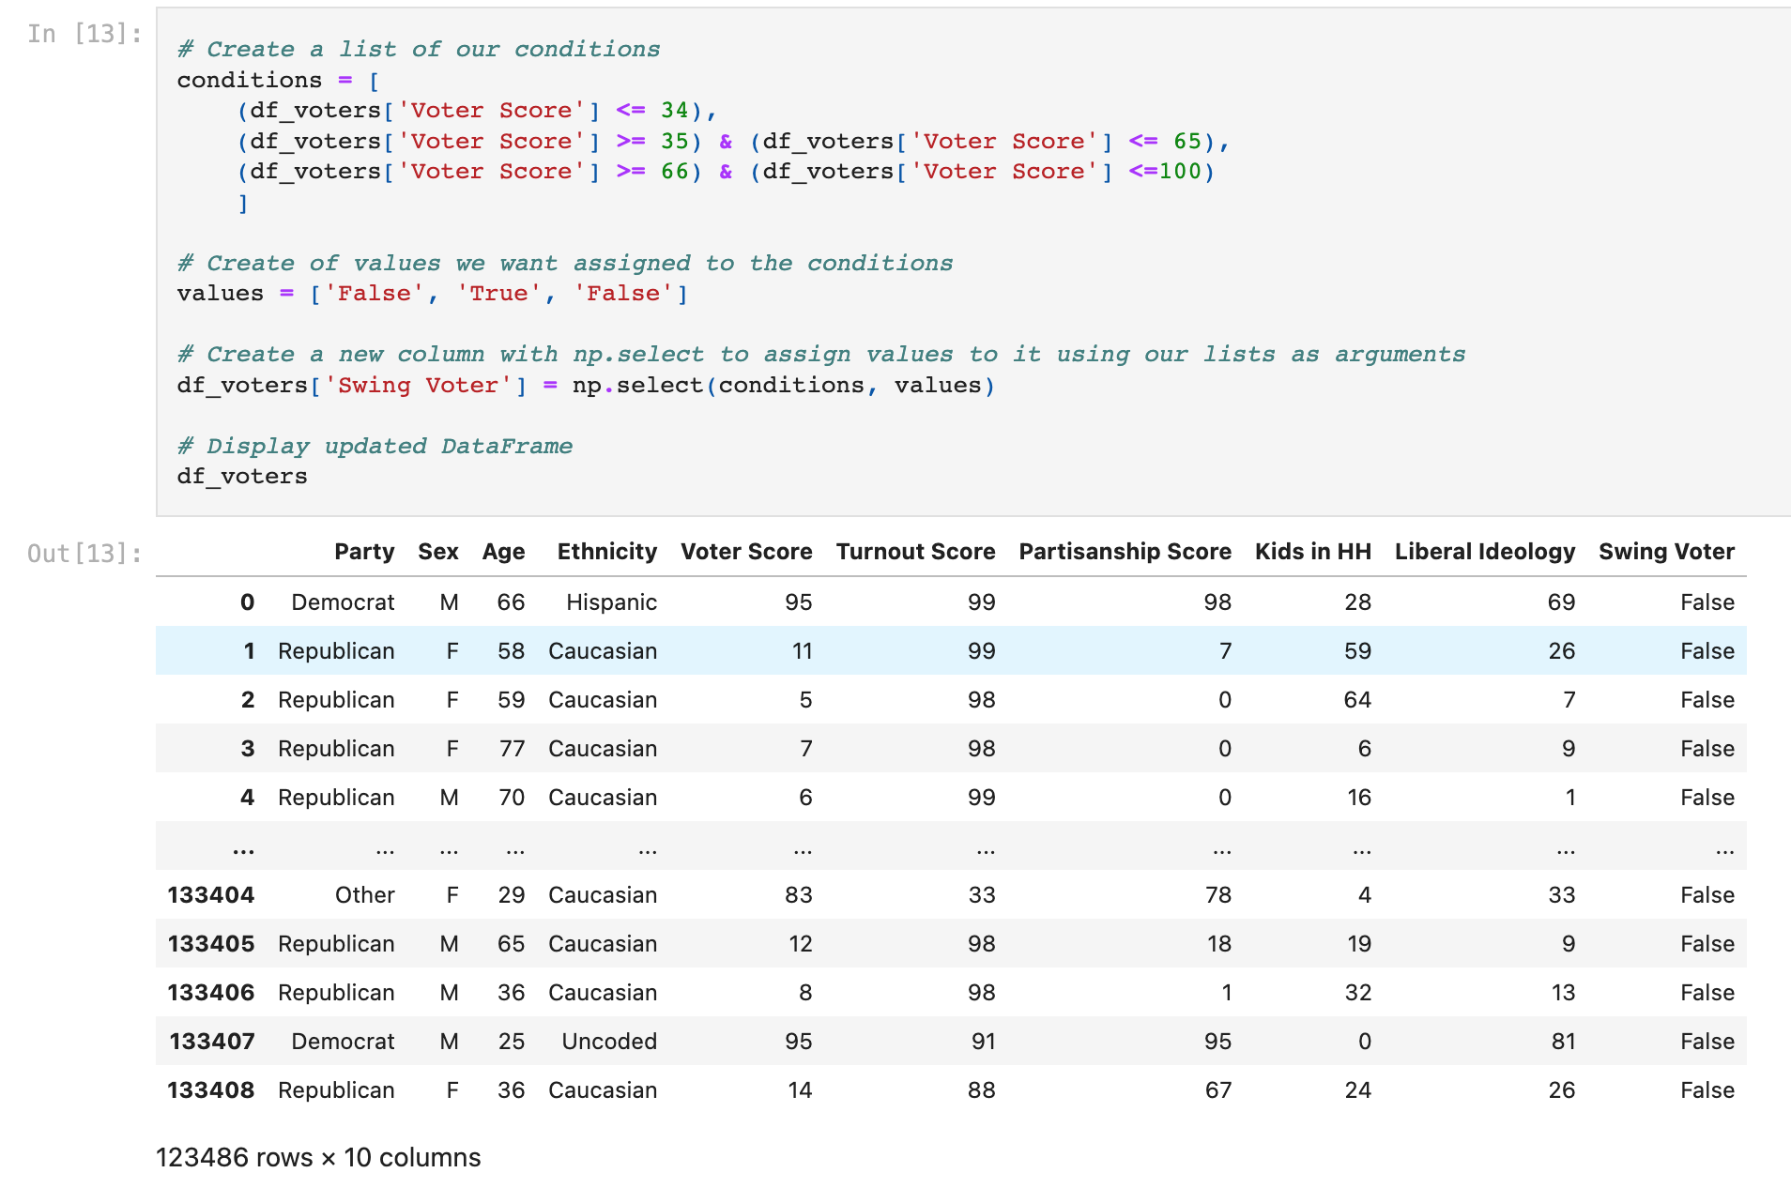
Description of Data Exploration

Slide 14
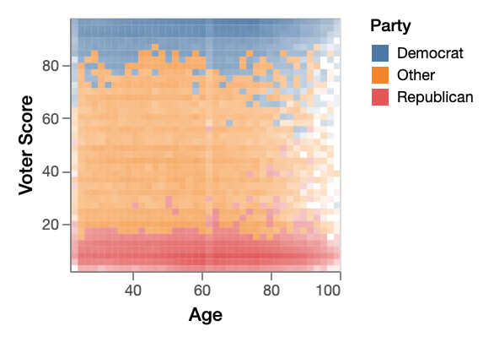
The graph above illustrates another critical element about Swing Voters in our districts. Over the last 20 years, Arizona politics like National politics has become more and more tribal. If you're a Democrat, you must be registered as a Democrat and vote for Democrats unconditionally and vise versa for Republicans. This graph shows that most Democrats have scores between 66-100 while most Republicans have scores between 0-34, regardless of age. As for Others/Independents, they do in fact fall in between the scores of 35-65, whereas roughly 5 percent of Democrats and Republicans are sprinkled in the Swing Voter scores of 35-65.

Slide 15
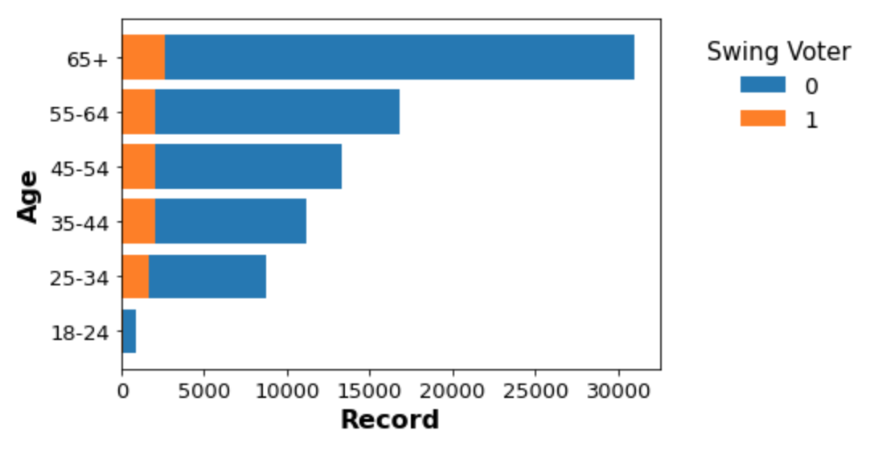
This graph above looks at the relationship between number of Swing Voters fall in each age bracket. The "1" is for a "High Chance" Swing Voter and the "0" is for a "Low Chance" Swing Voter. We broke down ages like this because this is how polling and the political industry buckets ages for audience targeting. This graph highlights that voters between ages of 25-54 have the most voters proportional to highly partisan voters. Specifically, voters between 25-44 have the highest proportionality and if you're spending money communicating with Swing Voters, this age group would be the most cost efficient. On the other side of that, voters over the age of 65 would be the most inefficient. We presume this age disparity of Swing Voters is likely because as people get older they are more likely to get set in their ways and are harder to persuade or unlikely to change their minds, especially on a topic that invokes such hostility like Politics.

Slide 16
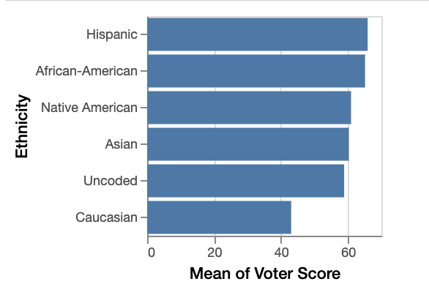
The graph above demonstrates that far and away "Caucasion" and "Uncoded"(meaning unknown) voters have a mean "Voter Scores" most aligned with what has been defined as a Swing Voter. This does not mean that every Caucasion or Uncoded voter are Swing Voters, rather that White voters have the largest range of "Voter Scores" compared to Hispanic, Black, Native American and Asian voters. This is true because Black and Hispanic voters heavily skewed towards the Democratic party. If you look at registration numbers, Black and Hispanic voters are registered with the Democratic Party 91 and 67 percent respectively.

Slide 17
Machine Learning model**
Prelinimary data: As describe above our preliminary raw file was provided by the Arizona democratic party and it contain 95 columns many which contain nan or null values. Before feeding our machinve learning model we agree to drop most of the columns for analysis from the start. We encounter an issue with our target column which was a range from 1 to 100 in percentages. this score is the likely hood of a voter being a split ticket voter. Fortounely we had access to what the score means, the score calculate the level of support towards the democratic party. The closer the score to 100 the more likely to vote democratic, on the opposite sepctrum the closer to 0 the more likely to vote only republican or other. After discussing with this team just by simple observation, we came to a assumption: "a score between 40% to 60% seem to be the range where voters are more likely to be split ticket voters.
Preliminary features: Our inital features were selected based after we drop most of our columns which cointain scores and data from previous years going back since 2016. All scores where product of other models run outside our project with different paramaters that we had no access to. Therefore we decided to drop all repeating columns, and score columns believing that feeding our model prediction scores from other models could errosnously create predictions in our model. Our features selections where mostly based on team communication, and also by running analyzis showing for example the represntation of each party in the district, gender and score and any correlations. Some of the columns that we end up droping where Voter ID since it is an individual number for each seperate data point.
Trainging and testing: For our training and testing data we also came into another issue and that was that we had object or quantitive data. We use get.dummies method to convert all of our features into numerical. Our target column was also converted by using a condition that would change our score between 40%-60% to Low-Chance and High-chance. We used a random state of 1 stratify= Y we used the default setting of the linear regression model to pick how many samples were to be used for training and for testing. We did intended to play with the n_estimators but it provided very little change in our model scores.
Modle Choice: We run several ML models to see which model will give us the best f1 score- since f1 score is the harmonic mean between precission and recall. Our team however cares more about the recall since we want to be able to advertise not only those who fall within the split ticker range but anyone who might be close to that range. At the end it seem Like a logistic regresion model using undersampling gave us a good satisfactory scores. Undersampling was required since the number of our target points was unmbalance.

Slide 18
Machine Language Programming
# Columns count
df_voters.count()

Slide 19
Machine Language Programming
# identify null values
df_voters.isnull()

Slide 20
Machine Language Programming
#drop any null or nan in the data frame
df_voters.dropna(axis = 0, how = "any", thresh = None, subset = None, inplace=True)
df_voters

Slide 21
Machine Language Programming
# Convert Float64 to int dtypes
df_voters = df_voters.astype({'Voter Score':'int','Kids in HH':'int','Liberal Ideology':'int'})
df_voters

Slide 22
Machine Language Programming
# Rename column 1
df_voters.rename(columns={'PartyName':'Party'}, inplace=True)
df_voters.head()

Slide 23
Machine Language Programming
# Create a list of our conditions
conditions = [
(df_voters['Voter Score'] <= 34),
(df_voters['Voter Score'] >= 35) & (df_voters['Voter Score'] <= 65),
(df_voters['Voter Score'] >= 66) & (df_voters['Voter Score'] <=100)
]
# Create of values we want assigned to the conditions
values = ['False', 'True', 'False']
# Create a new column with np.select to assign values to it using our lists as arguments
df_voters['Swing Voter'] = np.select(conditions, values)
# Display updated DataFrame
df_voters

Slide 24
Machine Language Programming
#Drop columns that doesn't impact Swing Voter chances
df_voters.drop(columns=["Voter Score"], inplace=True)
df_voters

Slide 25
Machine Language Programming
# Create a list of our conditions
conditions = [
(df_voters['Age'] >= 18) & (df_voters['Age'] <= 24),
(df_voters['Age'] >= 25) & (df_voters['Age'] <= 34),
(df_voters['Age'] >= 35) & (df_voters['Age'] <=44),
(df_voters['Age'] >= 45) & (df_voters['Age'] <=54),
(df_voters['Age'] >= 55) & (df_voters['Age'] <=64),
(df_voters['Age'] >= 65),
]
# Create of values we want assigned to the conditions
values = ['18-24', '25-34', '35-44','45-54','55-64','65+']
# Create a new column with np.select to assign values to it using our lists as arguments
df_voters['Age'] = np.select(conditions, values)
# Display updated DataFrame
df_voters

Slide 26
Machine Language Programming
# Convert the target column values to low_chance and high_chance based on values
x = {'False':'0'}
df_voters = df_voters.replace(x)
x = dict.fromkeys(['True'],'1')
df_voters = df_voters.replace(x)
df_voters.reset_index(inplace=True, drop=True)
df_voters

Slide 27
Machine Language Programming
new_voter_df = df_voters.drop(['Swing Voter'], axis=1)
new_voter_df

Slide 28
Machine Language Programming
# Save file
output_file_path = "/Users/joshzaragoza/Arizona_Election_Project/new_voter_data.csv"
new_voter_df.to_csv(output_file_path, index=False)

Slide 29
Machine Language Programming
# Load new dataframe
from path import Path
file_path = Path("/Users/joshzaragoza/Arizona_Election_Project/new_voter_data.csv")
df = pd.read_csv(file_path)
df.head(10)

Slide 30
Machine Language Programming
# Columns
df.columns

Slide 31
Machine Language Programming
# Changing to numerical by label encoder
from sklearn.preprocessing import LabelEncoder
number = LabelEncoder()
df["Party"] = number.fit_transform(df["Party"])
df["Sex"] = number.fit_transform(df["Sex"])
df["Age"] = number.fit_transform(df["Age"])
df["Ethnicity"] = number.fit_transform(df["Ethnicity"])
df

Slide 32
Machine Language Programming
# Looking for the best K
for i in k:
km = KMeans(n_clusters=i, random_state=0)
km.fit(df)
inertia.append(km.inertia_)
df

Slide 33
Machine Language Programming
Define a DataFrame to plot the Elbow Curve using hvPlot.

Slide 34
Machine Language Programming
efine a DataFrame to plot the Elbow Curve using hvPlot.
D
def get_clusters(k, data):
# Create a copy of the DataFrame
data = data.copy()
# Initialize the K-Means model
model = KMeans(n_clusters=k, random_state=0)
# Fit the model
model.fit(data)
# Predict clusters
predictions = model.predict(data)
# Create return DataFrame with predicted clusters
data["Swing Voter"] = model.labels_
return data

Slide 35
Machine Language Programming
# Plot the 3D-scatter with x="Party", y="Age" and z="Ethnicity"
fig

Slide 36
Machine Language
KMeans_Clusters_withPCA

Slide 37
Machine Language
KMeans_Clusters_withPCA
# Load new dataframe
# Changing to numerical by label encoder
# Initialize PCA model
# Get two principal components for the voter data.
# Find the best value for K
# Calculate the inertia for the range of K values
# Create the elbow curve
# Initialize the K-means model

Slide 38
Machine Language
KMeans_Clusters_withPCA
# Fit the model
# Predict clusters
# Add the predicted class columns

Slide 39
Machine Language
Hierarchical Clustering

Slide 40
Machine Language
LD4_Analytics_Lux
# Create a list of our conditions

Slide 41
Machine Language
LD4_Analytics_Lux
#Drop columns that doesn't impact Swing Voter chances

Slide 42
Machine Language
LD4_Analytics_Lux
# Changing to numerical by label encoder

Slide 43
Machine Language
LD4_Analytics_Lux
#Drop columns that doesn't impact Swing Voter chances

Slide 44
Machine Language
LD4_Analytics_Lux
# Print Lux Graph in Matplotlib

Slide 45
Machine Language
LD4_Analytics_Lux
Logistic_Regression_LD4

Slide 46
Machine Language
LD4_Analytics_Lux
#drop any null or nan in the data frame

Slide 47
Machine Language
LD4_Analytics_Lux
#drop any null or nan in the data frame
# Convert Float64 to int dtypes
# Rename column 1
# Create a list of our conditions
# Create of values we want assigned to the conditions
# Create a new column with np.select to assign values to it using our lists as arguments
# Display updated DataFrame
# Changing to numerical by label encoder
#Drop columns that doesn't impact Swing Voter chances

Slide 48
Machine Language
LD4_Analytics_Lux
Support Vectors Machine

Slide 49
Machine Language
LD4_Analytics_Lux
Logistic Regression

Slide 50
Machine Language
LD4_Analytics_Lux
Undersampling Majority (Second Option)

Slide 51
Communication Protocol
In case of emergency, we all have each other’s cell number.
The team communication consists of communicating daily over our Getz_Team Slack channel. In addition to that we have been meeting over Zoom multiple times (at least four times a week including the Mondays and Wednesdays classes) Also, we have been meeting in teams of twos when needed, for instance Franklin and Darlington, Franklin and Raymond, Franklin and Josh had met in few other times besides the normal scheduled times.

